Slide 1
Exploring Water Quality
Macroinvertebrate Identification

Slide 2
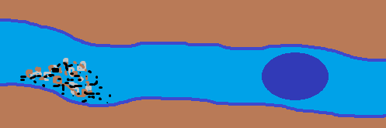
Sections of a stream
Riffle
Run
Pool
Notes:
Very short presentation to prepare students for a field trip to collect and identify macroinvertebrates.

Slide 3
Streams are an important part of the environment.
Streams move water
Many animals and plants live in streams
The animals and plants that live in streams are the basis of the food chain for many ecosystems.
Healthy streams = water for people to use
Grow crops, industry, drinking, cooking, washing

Slide 4
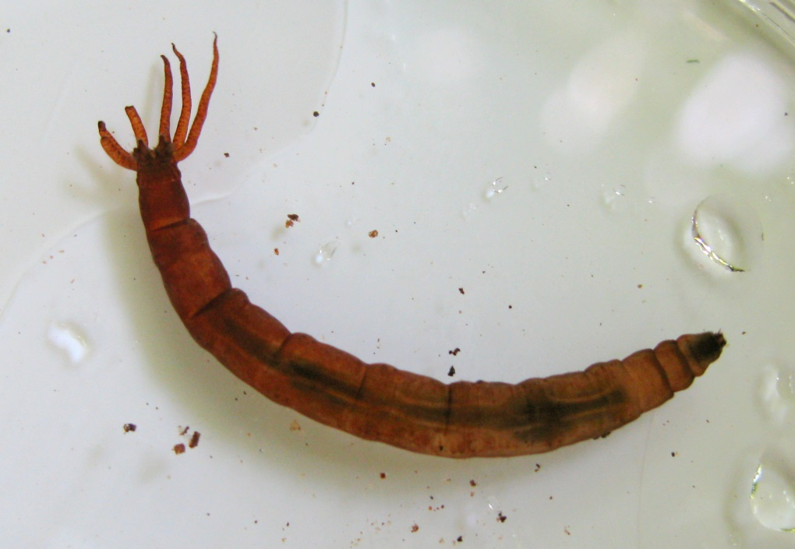
What is a macroinvertebrate?
Notes:
Left: Cranefly larva. Right: Stonefly nymph

Slide 5
What is a macroinvertebrate?
Macro – small but can be seen with out a microscope
Invertebrate – animal without a backbone
Insects (especially larval and nymph forms)
Snails
Crayfish
Aquatic worms
Notes:
Not a complete list, but what you are most likely to find in local streams

Slide 6
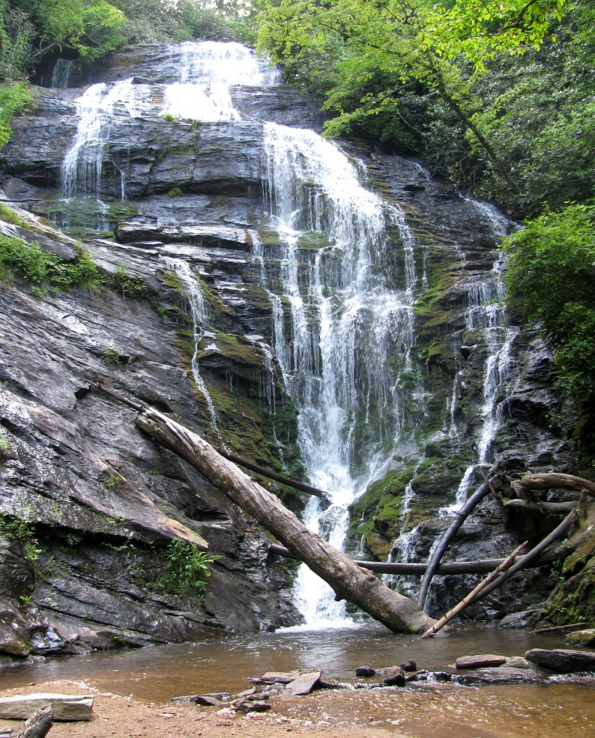
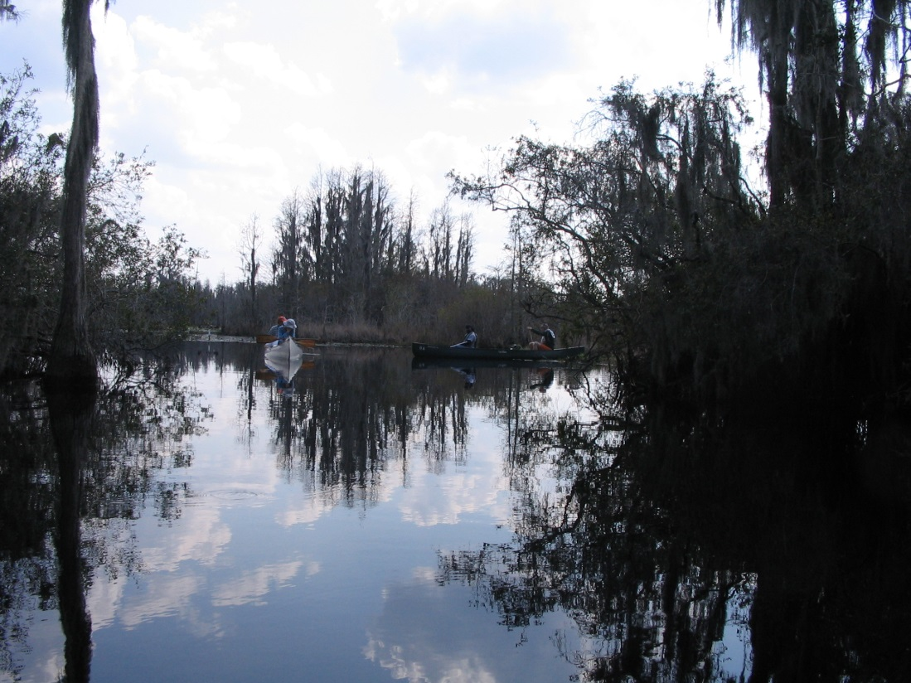
Why study macroinvertebrates
What happens to water in a stream?
Notes:
Water moves constantly…water in streams travels from the mountains to the sea

Slide 7
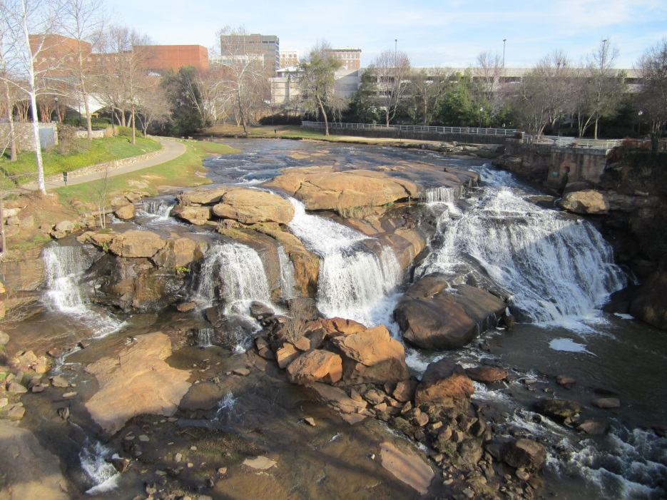
Water moves!
Water flows through streams and rivers from the mountains to the sea.
Taking a water sample only tells us what is happening in the stream RIGHT NOW because water moves.

Slide 8
Why study macroinvertebrates?
Macroinvertebrates live in water, and many live a long time
Macroinvertebrates are sensitive to pollutants in the water
Many macroinvertebrates cannot survive if there isn’t enough Dissolved Oxygen (DO) in the water, and most pollutants reduce DO levels
The presence or absence of sensitive macroinvertebrates can give us an idea about the overall quality of the water in a particular area

Slide 9
Collecting Macroinvertebrates
D-Nets
Identification Keys
Bowls – keep aquatic macroinvertebrates in water at all times
Notes:
Provide keys, bowls, and other collecting equipment (eye droppers, plastic spoons, petri dishes, etc.) to students in the field.

